Slide 1
Struts2 Localization & Annotations

Slide 2
Localization

Slide 3
Overview
- Internationalization (i18n) is the process of planning and implementing products and services so that they can easily be adapted to specific local languages and cultures, a process called localization.
Struts2 provides localization ie. internationalization (i18n)
Support through resource bundles, interceptors and tag libraries
Where places use:
The UI Tags
Messages and Errors.
Within action classes.

Slide 4
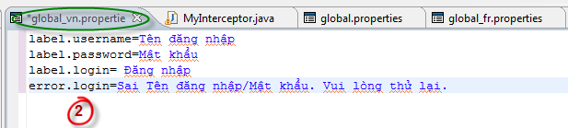
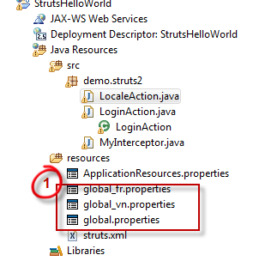
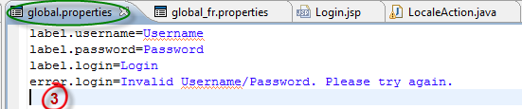
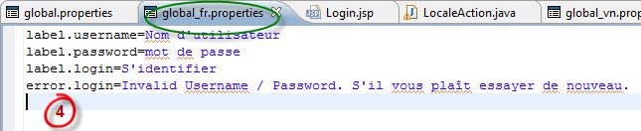
Create properties file
Use resource bundles to provide multiple language and locale options, format for a resource file is:
bundlename_language_country.properties
Create 3 properties files under resources folder
Put text into each file
Notes:
label.username=Username
label.password=Password
label.login=Login
error.login=Invalid Username/Password. Please try again.
label.username=Tên đăng nhập
label.password=Mật khẩu
label.login= Đăng nhập
error.login=Sai Tên đăng nhập/Mật khẩu. Vui lòng thử lại.
label.username=Nom d'utilisateur
label.password=mot de passe
label.login=S'identifier
error.login=Invalid Username / Password. S'il vous plaît essayer de nouveau.

Slide 5
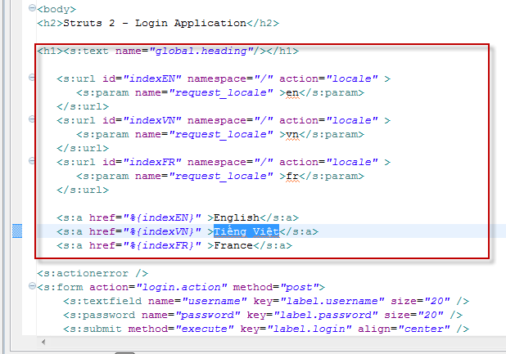
Add tags
In Login.jsp file, put block codes as bellowing here:
Notes:
<h1><s:text name="global.heading"/></h1>
<s:url id="indexEN" namespace="/" action="locale" >
<s:param name="request_locale" >en</s:param>
</s:url>
<s:url id="indexVN" namespace="/" action="locale" >
<s:param name="request_locale" >vn</s:param>
</s:url>
<s:url id="indexFR" namespace="/" action="locale" >
<s:param name="request_locale" >fr</s:param>
</s:url>
<s:a href="%{indexEN}" >English</s:a>
<s:a href="%{indexVN}" >Tiếng Việt</s:a>
<s:a href="%{indexFR}" >France</s:a>

Slide 6
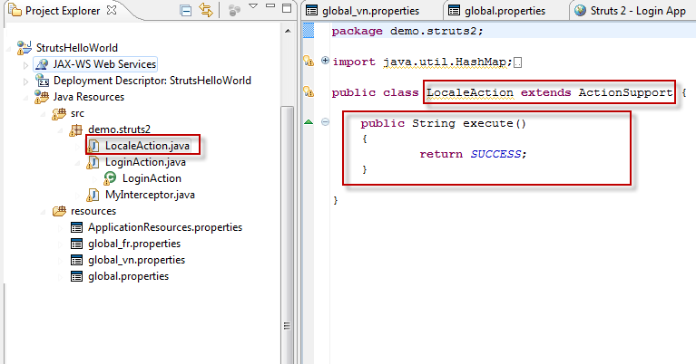
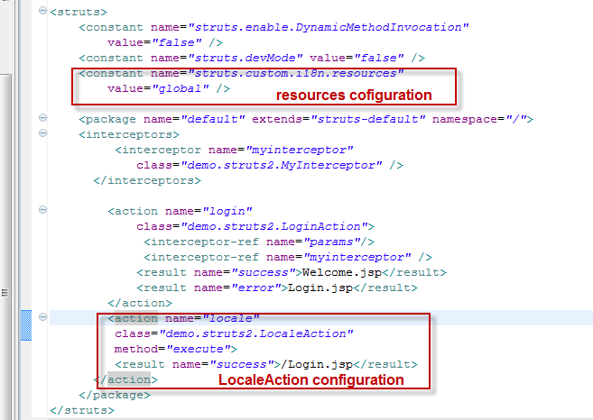
Create LocaleAction
Create a LocaleAtion class:
Configuration in struts.xml:
Notes:
LocaleAction:
package demo.struts2;
import java.util.HashMap;
import java.util.Map;
import com.opensymphony.xwork2.ActionContext;
import com.opensymphony.xwork2.ActionSupport;
import com.opensymphony.xwork2.util.ValueStack;
public class LocaleAction extends ActionSupport {
public String execute()
{
return SUCCESS;
}
}

Slide 7
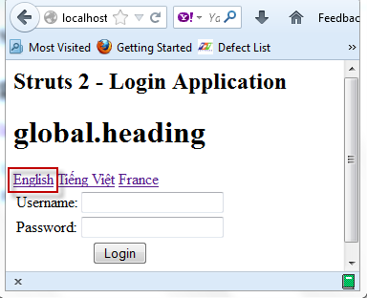
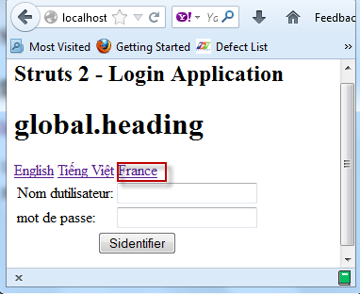
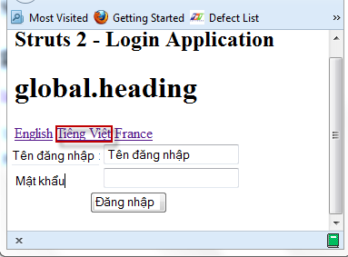
Run & View
Notes:
Click each link to change language

Slide 8
Annotations

Slide 9


Overview
- Struts provides two forms of configuration. The traditional way is to use the struts.xml file for all the configurations.
- Struts2 uses the Java 5 Annotations feature: Using the struts annotations what must not configuration in struts.xml
- Use @Results to setup action name, forward name without struts.xml:
- Use @RequiredFieldValidator to validate data:

Slide 10
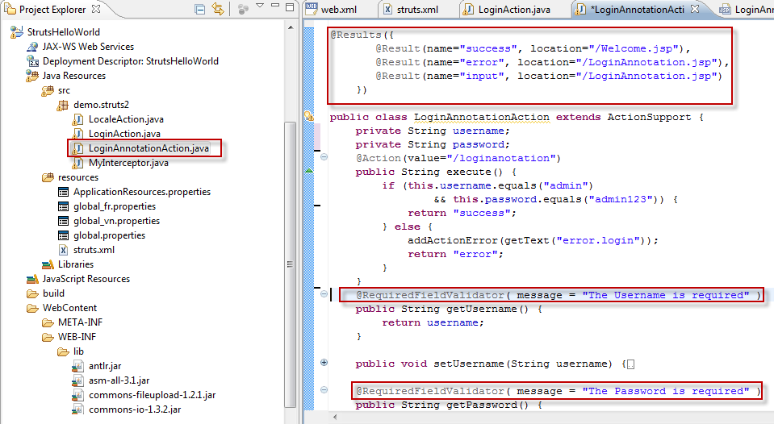
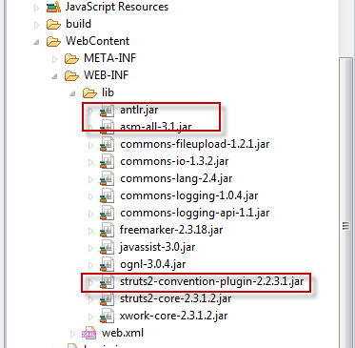
Create Example
Add 3 jars libs to use: antlr.jar, asm.xx.jar, struts2-convention-plugin-xxx.jar
Create LoginAnnotaton.java class
Notes:
package demo.struts2;
import com.opensymphony.xwork2.ActionSupport;
import org.apache.struts2.convention.annotation.Action;
import org.apache.struts2.convention.annotation.Result;
import org.apache.struts2.convention.annotation.Results;
import com.opensymphony.xwork2.validator.annotations.*;
@Results({
@Result(name="success", location="/Welcome.jsp"),
@Result(name="error", location="/LoginAnnotation.jsp"),
@Result(name="input", location="/LoginAnnotation.jsp")
})
public class LoginAnnotationAction extends ActionSupport {
private String username;
private String password;
@Action(value="/loginanotation")
public String execute() {
if (this.username.equals("admin")
&& this.password.equals("admin123")) {
return "success";
} else {
addActionError(getText("error.login"));
return "error";
}
}
@RequiredFieldValidator( message = "The Username is required" )
public String getUsername() {
return username;
}
public void setUsername(String username) {
this.username = username;
}
@RequiredFieldValidator( message = "The Password is required" )
public String getPassword() {
return password;
}
public void setPassword(String password) {
this.password = password;
}
}

Slide 11
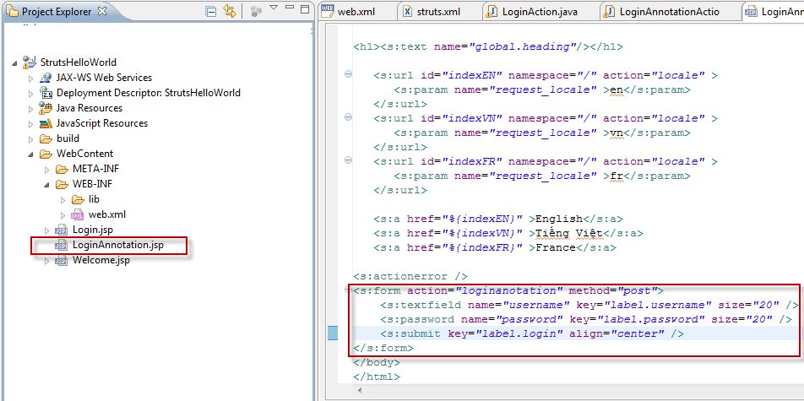
Create JSP
Create LoginAnnotaton.jsp file
Notes:
<%@ page contentType="text/html; charset=UTF-8"%>
<%@ taglib prefix="s" uri="/struts-tags"%>
<html>
<head>
<title>Struts 2 - Login Application | ViralPatel.net</title>
</head>
<body>
<h2>Struts 2 - Login Application with Annotations</h2>
<h1><s:text name="global.heading"/></h1>
<s:url id="indexEN" namespace="/" action="locale" >
<s:param name="request_locale" >en</s:param>
</s:url>
<s:url id="indexVN" namespace="/" action="locale" >
<s:param name="request_locale" >vn</s:param>
</s:url>
<s:url id="indexFR" namespace="/" action="locale" >
<s:param name="request_locale" >fr</s:param>
</s:url>
<s:a href="%{indexEN}" >English</s:a>
<s:a href="%{indexVN}" >Tiếng Việt</s:a>
<s:a href="%{indexFR}" >France</s:a>
<s:actionerror />
<s:form action="loginanotation" method="post">
<s:textfield name="username" key="label.username" size="20" />
<s:password name="password" key="label.password" size="20" />
<s:submit key="label.login" align="center" />
</s:form>
</body>
</html>

Slide 12
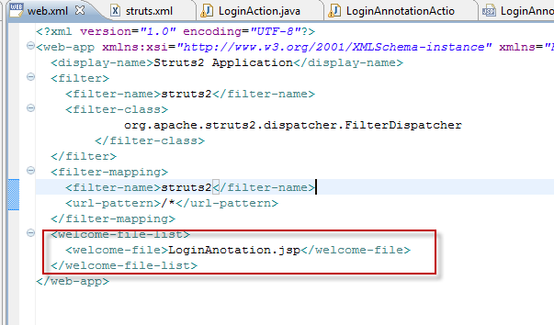
Configuration in web.xml
Set LoginAnotation.jsp as the first page loading
Notes:
<?xml version="1.0" encoding="UTF-8"?>
<web-app xmlns:xsi="http://www.w3.org/2001/XMLSchema-instance" xmlns="http://java.sun.com/xml/ns/j2ee" xmlns:javaee="http://java.sun.com/xml/ns/javaee" xmlns:web="http://java.sun.com/xml/ns/javaee/web-app_2_5.xsd" xsi:schemaLocation="http://java.sun.com/xml/ns/j2ee http://java.sun.com/xml/ns/j2ee/web-app_2_4.xsd" id="WebApp_9" version="2.4">
<display-name>Struts2 Application</display-name>
<filter>
<filter-name>struts2</filter-name>
<filter-class>
org.apache.struts2.dispatcher.FilterDispatcher
</filter-class>
</filter>
<filter-mapping>
<filter-name>struts2</filter-name>
<url-pattern>/*</url-pattern>
</filter-mapping>
<welcome-file-list>
<welcome-file>LoginAnotation.jsp</welcome-file>
</welcome-file-list>
</web-app>

Slide 13
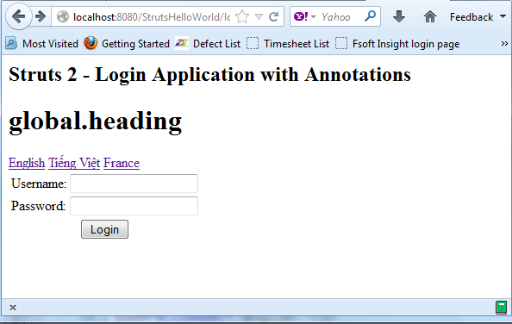
Run & View
Return Result as same when configuration without annotation

Slide 14
Summary
- Localization: To handle form validation automatically and it can handle both server side as well as client side form validation can easily be adapted to specific local languages and cultures.
- Using the struts annotations what must not configuration in struts.xml

Slide 15
Q & A

